Slide 1
Web Services Publishing and Discovery
Service-Oriented Software Engineering
Software Institute
Nanjing University
Bei Jia

Slide 2
Publishing a Web Service in Registry
The implementation of Web services is deployed onto an application server accessible to Internet
Then publish it to a service registry on the Internet so that it can be found by any user
The service registry provides the information that service requesters need to discover services providers and their Web service, instead of actual implementation
  Service name
  Service provider’s name
  URL of the WSDL file describing a service

Slide 3
Web services publishing approaches
Publish to
  A centralized services registry
    UDDI
  A distributed services registry
    Web Services Inspection Language (WS-Inspection Language or WSIL)

Slide 4
UDDI (1/3)
Universal Description, Discovery, and Integration (UDDI) is used to provides “meta service” for publishing and locating Web Services by enabling robust queries against rich metadata
UDDI defines a mechanism to store descriptions of registered Web services in term of XML messages
The UDDI specifications record information about
  WHO, basic information about a business
  WHAT, classification information
  WHERE, registration information
  HOW, registration references about interfaces and other properties of a given service

Slide 5
UDDI (2/3)
UDDI registry entries store published information about Web Services.
  White Pages: information such as name, address, i.e. contact details
  Yellow Pages: information such as categorization of businesses or services
    Industry: NAICS (North American Industry Classification System)
    Product/Services: UNSPSC (United Nations Standard Products and Services Code)
    Location: Geographical taxonomy
  Green Pages: information such as technical data about services

Slide 6
UDDI (3/3)
Contains five main elements
  businessEntitiy, physical business by describing its information and its offered services
  businessService, service offered by a business
  bindingTemplate, how to invoke a service
  Technical Models (tModel), unique concepts or structures
  publisherAssertion, indicate business relationship
Use XML schema to formally describe its data structure

Slide 7
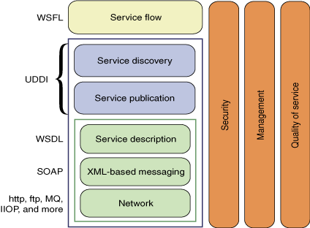
Protocol stack of UDDI
Web Services Flow Language, one of the origins of BPEL

Slide 8
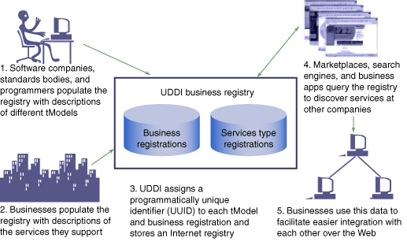
The workflow of UDDI

Slide 9
Public/private UDDI publishing
A UDDI is a centralized repository that maintains a set of links of published Web services
UDDI also provides information about corresponding services providers
A UDDI registry provides a SOAP interface to enable SOAP message-based service publishing
Can be divided into public/private UDDI with the access control policies

Slide 10
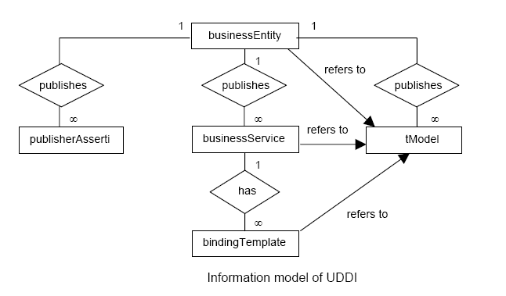
UDDI Information Model

Slide 11
businessEntitiy (1/2)
<businessEntity businessKey="0ADACD80-2913-11DA-B2FE-000629DC0A53" operator="www.ibm.com/services/uddi" authorizedName="06000F049">
<discoveryURLs>
<discoveryURL useType="businessEntity"/>http://uddi.ibm.com/testregistry/uddiget?businessKey=0ADACD80-2913-11DA-B2FE-000629DC0A53</discoveryURLs>
<name xml:lang="en">AdvantWise Systems</name>
<description xml:lang="zh">AdvantWise系统公司提供计算机硬件设备</description>
<!--自定义的中国企业工商注册号-->
<identifierBag>
<keyedReference tModelKey="UUID:28882A90-2917-11DA-B2FE-000629DC0A53" keyName="AdvantWise Systems" keyValue="9903005218088"/>
</identifierBag>

Slide 12
businessEntitiy (2/2)
<categoryBag>
<!--UNSPSC category-->
<keyedReference tModelKey="UUID:DB77450D-9FA8-45D4-A7BC-04411D14E384" keyName="Computer Equipment and Accessories" keyValue="43210000"/>
<!--NAICS category-->
<keyedReference tModelKey="UUID:C0B9FE13-179F-413D-8A5B-5004DB8E5BB2" keyName="Computer and Electronic Product Manufacturing" keyValue="334"/>
<!--ISO Geography category-->
<keyedReference tModelKey="UUID:4E49A8D6-D5A2-4FC2-93A0-0411D8D19E88" keyName="China" keyValue="CN"/>
</categoryBag>
</businessEntity>

Slide 13
businessService
<businessService businessKey="0ADACD80-2913-11DA-B2Fe-000629DC0A53" serviceKey="E3DFE280-291A-11DA-B2Fe-000629DC0A53">
<name>Purchase Computer Service</name>
<description xml:lang="en">
Purchase Computer Service
</description>
<bindingTemplates>
<!--Omitted-->
</bindingTemplates>
<categoryBag>
<!--UNSPSC category-->
<keyedReference tModelKey="UUID:DB77450D-9FA8-45D4-A7BC-04411D14E384" keyName="Computer Equipment and Accessories" keyValue="43210000"/>
</categoryBag>
</businessService>

Slide 14
bindingTemplate
<bindingTemplates>
<bindingTemplate bindingKey="57C8EA90-2952-11DA-B2FE-000629DC0A53" serviceKey="E3DFE280-291A-11DA-B2FE-000629DC0A53">
<description>Purchase Computer Service</description>
<accesssPoint URLType="http">
http://www.AdvantWise.com/purchasegoods
</accesssPoint>
<!--指向技术模型实例-->
<tModelInstanceDetails>
<tModelInstanceInfo tModelKey=“UUID:38B8FBC0-2984-11DA-B2FE-000629DC0A53"/>
</tModelInstanceDetails>
</bindingTemplate>
</bindingTemplates>

Slide 15
tModel (wsdl)
<tModel tModelKey=“UUID:38B8FBC0-2984-11DA-B2FE-000629DC0A53">
<name>http://www.AdvantWise.com/PurchaseGoods-interface</name>
<description xml:lang="en">
Purchase Computer Interface
</description>
<!--综述文档-->
<overviewDoc>
<description xml:lang="en">
WSDL Service Interface Document
</description>
<overviewURL>
http://www.AdvantWise.com/PurchaseGoods-interface.wsdl#purchaseBinding
</overviewURL>
</overviewDoc>
<!--分类信息-->
<categoryBag>
<keyedReference tModelKey="UUID:C1ACF26D-9672-4404-9D70-39B756E62AB4" keyName="uddi-org:types" keyValue="wsdlSpec"/>
<keyedReference tModelKey="UUID:DB77450D-9FA8-45D4-A7BC-04411D14E384" keyName="Computer Equipment and Accessories" keyValue="43210000"/>
</categoryBag>
</tModel>

Slide 16
tModel (中国企业工商注册号)
<tModel tModelKey="UUID:28882A90-2917-11DA-B2FE-000629DC0A53">
<name>China Enterpise Industry and Commerical Register Number</name>
<description xml:lang="zh">
中国工商注册号
</description>
<!--综述文档-->
<overviewDoc>
<overviewURL>
http://www.china-industry.com
</overviewURL>
</overviewDoc>
<!--分类信息-->
<categoryBag>
<keyedReference tModelKey="UUID:C1ACF26D-9672-4404-9D70-39B756E62AB4" keyName="Unique Identifier" keyValue="identifier"/>
</categoryBag>
</tModel>

Slide 17
publisherAssertion
<publisherAssertion >
<fromKey>
0ADACD80-2913-11DA-B2FE-000629DC0A53
</fromKey>
<toKey>
A547F090-2987-11DA-B2FE-000629DC0A53</toKey>
<keyedReference tModelKey="UUID:807A2C6A-EE22-470D-ABC7-E0424A337C03" keyName="parent-child" keyValue="parent-child"/>
</publisherAssertion >

Slide 18
UDDI Basic Type System

Slide 19
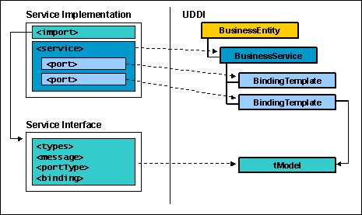
Mapping from WSDL to UDDI

Slide 20
Binding WSDL to tModel
<tModel tModelKey="uuid:49662926-f4a5-4ba5-b8d0-32ab388dadda">
<name>
StockQuoteSoapBinding
</name>
<overviewDoc>
<overviewURL>http://location/sample.wsdl</overviewURL>
</overviewDoc>
<categoryBag>
<keyedReference tModelKey="uuid:c1acf26d-9672-4404-9d70-39b756e62ab4" keyName="uddi-org:types" keyValue="wsdlSpec"/>
<!--可以包含其他分类-->
</categoryBag>
</tModel>

Slide 21
History
UDDI V1.0 (2000): Create foundation for registry of Internet-based business services
UDDI V2.0 (2003): Align specification with emerging Web services standards and provide support for flexible, external taxonomies
UDDI V3.0 (Feb 2005): Support secure interaction of private and public implementations as key element of service-oriented infrastructure
  This specification reflects the understanding of the need of supporting mostly business internal Web services infrastructure rather than highly distributed ones
  Current implementation recognizes the need for federated control in real-world environments and further integrates the standard with other elements of service oriented infrastructure

Slide 22
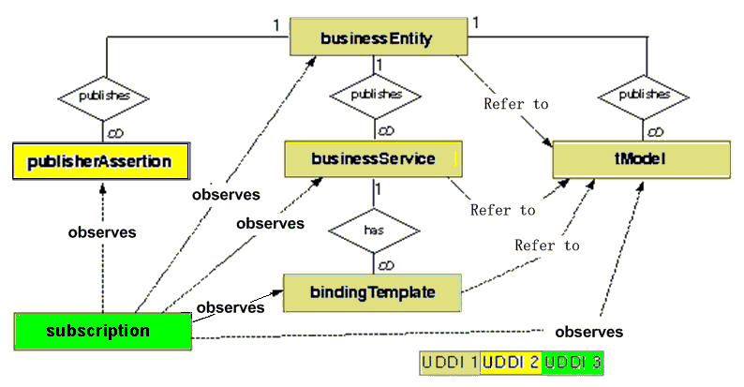
The Evolvement of Core data Structure

Slide 23
UDDI v3 new features
Support for registry affiliation
Publisher assigned keys
  Human-friendly, URI-based keys
Subscription API
Support for digital signatures
Information Model Improvements
  categoryBags on bindingTemplates
  Operational information
  Support for Complex Categorization
Extended Discovery Features
  Support for previous multi-step queries into single-step complex queries
  Extended Wildcard support
  Management of large results sets

Slide 24
UDDI API
对于分类、编目和管理Web服务，UDDI注册库提供了一个标准方式，以便于能够发现和使用这些Web服务
  业务和提供者可以按标准方式使用UDDI来表示Web服务信息
  UDDI使用SOAP作为它的传输层
UDDI API是一个接口，可以接受封装在SOAP信封中的XML消息
  所有的UDDI交互都使用请求/响应模式
  可以使用出查询API来搜索和读取UDDI注册库中的数据，并可使用发布API来添加、更新和删除UDDI注册库中的数据

Slide 25
UDDI 发布API
通过发布接口，企业可以存储和更新包含在UDDI注册库中的信息
发布API支持4类操作
  授权：客户端可以获得相应的访问权限、获取授权令牌、终止会话和授权令牌
    get_authtoken：将客户端记录到注册
    discard_authtoken：终止会话，并从注册库中删除客户端
  保存：客户端可以在UDDI中添加或更新信息
  获取：可以获取客户端所发布的数据结构的概要数据
  删除：客户端可以在UDDI中删除信息

Slide 26
WSIL Publishing
Web services is published to a regular Web server as a plain XML document
Web Services Inspection language (WSIL) are used to aggregate references from existing service description documents
A reference pointer can be used to connect to a service published in a UDDI registry or connect to another WSIL document
So the WSIL chains are formed

Slide 27
A example of WSIL chain

Slide 28
StockQuote.wsil (1/2)
<?xml version="1.0" encoding="UTF-8"?>
<inspection xmlns="http://schemas.xmlsoap.org/ws/2001/10/inspection/" xmlns:wsiluddi="http://schemas.xmlsoap.org/ws/2001/10/inspection/uddi/">
<service>
<abstract>A stock quote service with two descriptions</abstract>
<description referencedNamespace="http://schemas.xmlsoap.org/wsdl/" location="http://example.com/stockquote.wsdl"/>
<description referencedNamespace="urn:uddi-org:api">
<wsiluddi:serviceDescription location="http://www.example.com/uddi/inquiryapi">
<wsiluddi:serviceKey>
4FA28580-5C39-11D5-9FCF-BB3200333F79
</wsiluddi:serviceKey>
</wsiluddi:serviceDescription>
</description>
</service>
Direct link
Web Service with 2 description
uuid

Slide 29
StockQuote.wsil (2/2)
<service>
<description referencedNamespace="http://schemas.xmlsoap.org/wsdl/" location="ftp://anotherexample.com/tools/calculator.wsdl"/>
</service>
<link referencedNamespace=http://schemas.xmlsoap.org/ws/2001/10/inspection/
location="http://example.com/Supply.wsil"/>
</inspection>
The linked WSIL

Slide 30
Supply.wsil (1/2)
<?xml version="1.0" encoding="UTF-8"?>
<inspection xmlns=…>
<service>
<abstract>
This supply service provides an online purchase order handling service.
</abstract>
<name xml:lang="en-US">SupplyService</name>
<description location="supply.wsdl"
referencedNamespace="http://servicescomputing.org/wsdl/">
<unknown:service-description type="unknown"/>
</description>
</service>
Name of the service
The correponding WSDL document

Slide 31
Supply.wsil (2 of 2)
<link location="payment.wsil"
referencedNamespace="http://servicescomputing.org/wsdl/">
<abstract>
Link to the WSIL document for payment service.
</abstract>
</link>
<link location="shipping.wsil"
referencedNamespace="http://servicescomputing.org/wsdl/">
<abstract>
Link to the WSIL document for shipping service.
</abstract>
</link>
</inspection>
The linked WSIL

Slide 32
Shipping.wsil
<?xml version="1.0" encoding="UTF-8"?>
<inspection xmlns=…>
<service>
<abstract>
The WSDL service desciption for the shippingservice
</abstract>
<name xml:lang="en-US">ShippingService</name>
<dedcription location="shipping.wsdl" referencedNamespace="http://servicescomputing.org/wsdl/">
</dedcription>
</service>
</inspection>
No links

Slide 33
Payment.wsil
<?xml version="1.0" encoding="UTF-8"?>
<inspection xmlns=…>
<service>
<abstract>The WSDL service desciption for the online payment service. </abstract>
<name xml:lang="en-US">OnlinePaymentService</name>
<dedcription location="payment.wsdl" referencedNamespace="http://servicescomputing.org/wsdl/">
</dedcription>
</service>
<link referencedNamespace="http://schema.xmlsoap.org/ws/2001/10/inspection"
location="bank.wsil">
<abstract>
Link to a spectific bank service provider.
</abstract>
</link>
</inspection>
Not listed

Slide 34
UDDI Publishing vs. WSIL Publishing
UDDI can be viewed as a traditional Yellow page directory that categorizes and organizes published Web services form various organizations
WSIL enables Web services discovery, deployment, and invocation through regular Web server without a comprehensive and complex services registry infrastructure
The cost and complexity is different, choice between Yellow page directory or asking around for information

Slide 35
Web Services Discovery

Slide 36
UDDI Search (1/2)
Adopts a UDDI client to look up a Web service in UDDI registry
UDDI for Java (UDDI4J) is such a UDDI client
  Is a java class library that provides an API to interact with a UDDI registry
  Supports the UDDI specifications, SOAP transports, debug logging, and configuration capabilities

Slide 37
UDDI Search (2/2)
Three directions
  Search for Business
    Search by business name
    Search by identifier
    Search by category
    Search by discovery URL
  Search for Service
    Search by service name
    Search by category
  Search for Service Type
    Search by service type name
    Search by category
Some categorization taxonomies
  North American Industry Classification System (NAICS)
  Universal Standard Products and Services Classification (UNSPSC)
  Geographic (GEO)

Slide 38
UDDI 查询API
UDDI查询API有两类使用模式
  浏览
    开发者可以使用浏览模式（发现API调用）来获取满足比较宽泛的查询标准的接入点、服务或者技术特性
    浏览模式中，可以使用find_business、find_relatedBusiness、find_service、find_binding和find_tModel操作
  下钻
    使用下钻模式（获取API调用）来获取更具体的功能部件
    下钻模式中，可以使用get_businessDetail、get_BusinessDetailExt、get_serviceDetail、get_bindingDetail和get_tModelDetail操作

Slide 39
WSIL Search (1/2)
Mainly based upon an iterative search process through a WSIL document chain
  Step 1: Indentify the location of a starting WSIL document
  Step 2: Perform the search for the specified WSIL document
  Step 3: Display a list of links contains in the WSIL document
  Step 4: Select a link to launch the content of the selected WSIL document. If the launched document contains other links, chase down the links to retrieve further document
  Step 5: Repeat Steps 3 and 4 to iterate through all interested links until indented information is found

Slide 40
WSIL Search (2/2)
Usually performed by a search tool built on top of WSIL parser
For example, the Web Services Inspection language for Java API (WSIL4J), it is used to parse existing WSIL documents or programmatically create new WSIL documents
  Classes to present elements in WSIL
  WSILProxy to access the information in WSIL documents

Slide 41
JAXR (1/3)
JAXR is
  Standard Java API for performing registry operations over diverse set of registries
  A unified information model for describing business registry content
  Provides multi-layered API abstractions
  Enabling technology for web services in the JavaEE platform
JAXR
  Is not a new registry standard
    JAXR defines Java APIs for accessing various current and future registries
  Is not least common denominator API
    JAXR supports a union of the best features of dominant registry specifications

Slide 42
JAXR (2/3)
Registry Provider
  Provides an implementation of a registry specification
  Is not expected to implement JAXR specification
  examples: UDDI registry, ebXML registry
JAXR Provider
  Implements JAXR specification
  Typically functions as facade to existing registry providers
  example: JAXR reference implementation
JAXR Client
  Uses JAXR APIs to access services provided by JAXR Provider

Slide 43
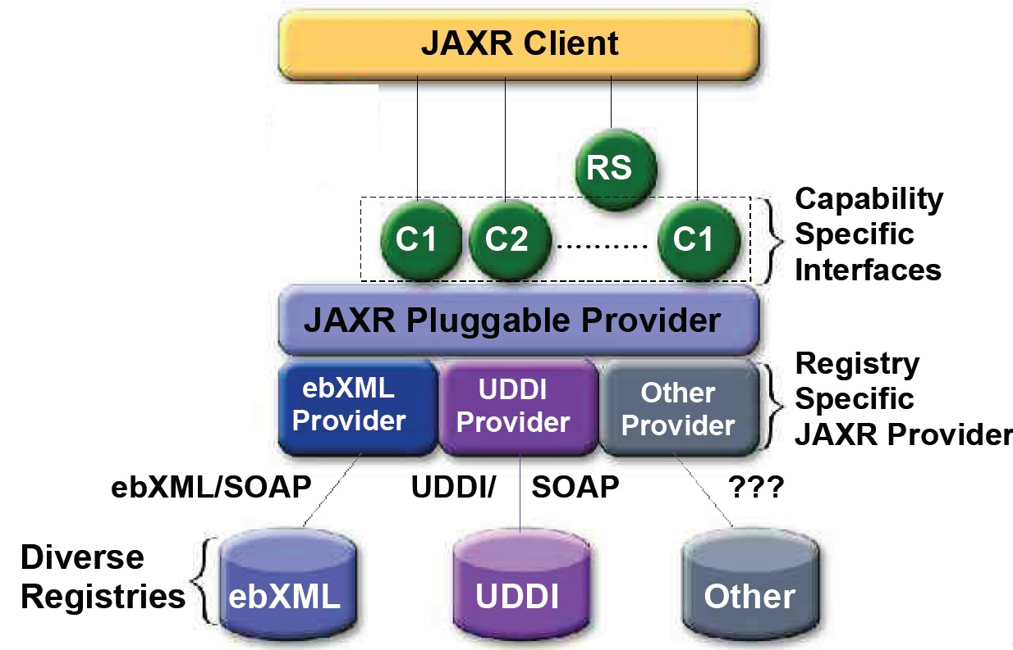
JAXR (3/3)

Slide 44
Read More… (1/2)
题名/责任者:Services computing = 服务计算 / Liang-Jie Zhang, Jia Zhang, Hong Cai.
出版发行项:Beijing : Tsinghua University Press ; Berlin ; New York : Springer, c2007.
ISBN:9787302150756 (Tsinghua University Press)
ISBN:9783540382812 (Springer)
URL: http://202.119.47.8:8080/opac/item.php?marc_no=0003334218

Slide 45
Read More… (2/2)
UDDI Spec TC
URL: http://www.uddi.org/pubs/uddi_v3.htm
An overview of the Web Services Inspection Language
URL: http://www.ibm.com/developerworks/webservices/library/ws-wsilover/
Java API for XML Registries (JAXR)
URL: http://www.oracle.com/technetwork/java/jaxr-138137.html

